Slide 1
Neighbourhood analysis – chennai

Slide 2
Problem Statement
Being the capital of Tamilnadu, a lot of people continuously Hail to Chennai. people coming from outside Chennai might not know more about its Neighbourhoods.
Clustering of Neighbourhoods in Chennai for finding the best Neighbourhood to live in Chennai based on distribution of several kinds of venues .
people who would want to shift to Chennai from other cities

Slide 3
Data
The data of several Neighbourhoods of Chennai are Scrapped from this Wikipedia page - https://en.wikipedia.org/wiki/Areas_of_Chennai .
With Names of each Neighbourhood, the Latitude and longitudes of each Neighbourhood are scrapped from geopy python library.
The Geospatial data containing the information of venues around each Neighbourhood is collected through Foursquare api.
The dataframe containing the Type of Neighbourhood is scrapped as a csv file from internet.

Slide 4
Foursquare API
Foursquare API is one of the major Geospatial data collectors that provide Geospatial data at free of cost.
Using an API key and a API secret we could acess the foresquare’s data.
Using Foursquare API we derived the venues around each Neighbourhood.

Slide 5
Clustering
Clustering of Neighbourhoods is achieved using K –Means Clustering Algorithm.
K – means Clustering is the best suited algorithm for Clustering this Neighbourhoods data (unlabeled data).
The number of Clusters opted for this data is 4 Clusters.

Slide 6
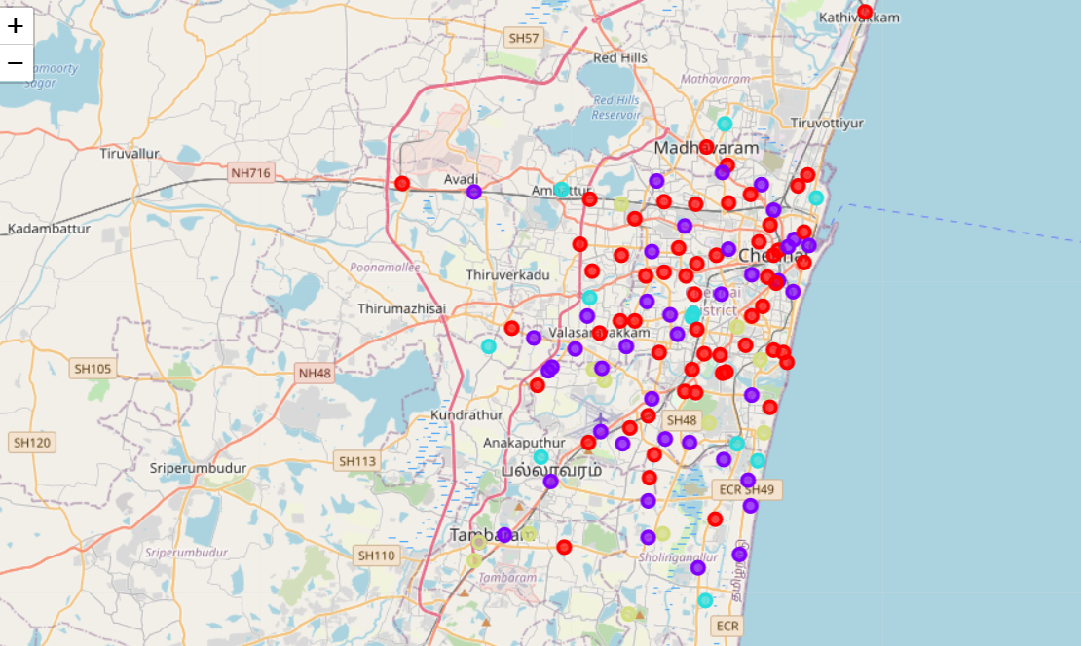
Neighbourhoods after Clustering

Slide 7
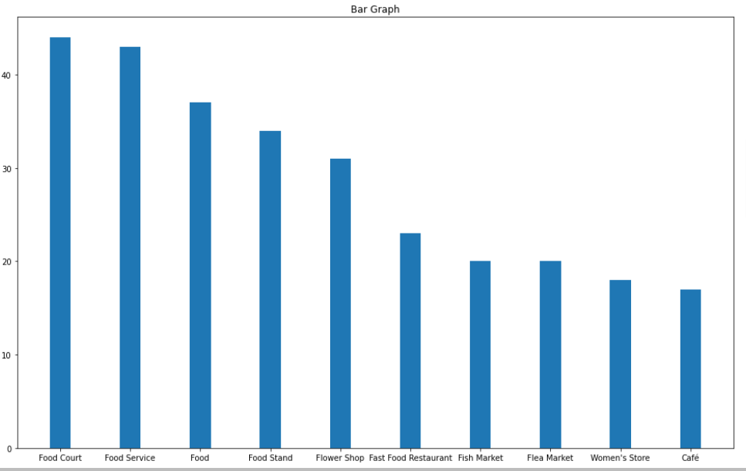
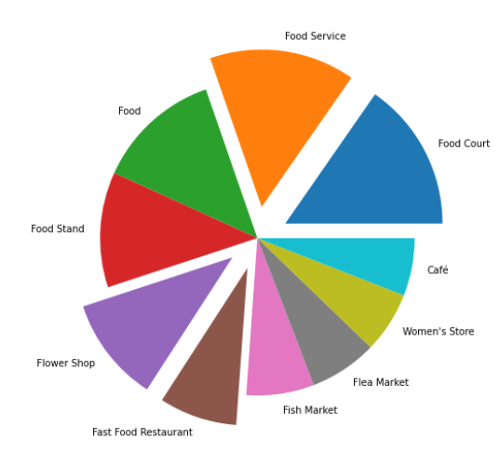
Analayzing Each Clusters
Cluster 1

Slide 8
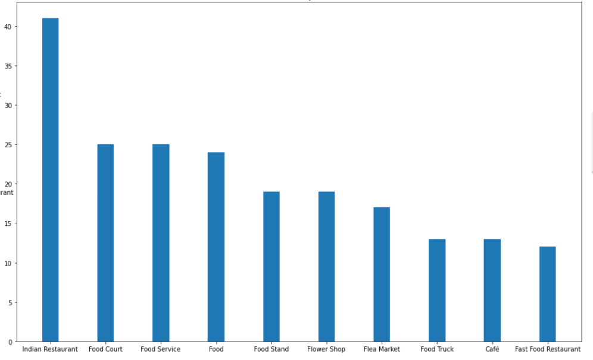
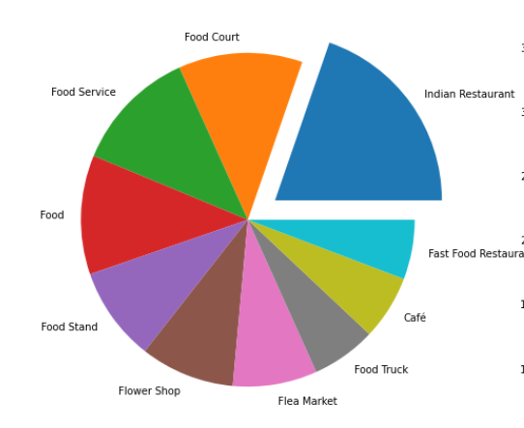
Cluster 2

Slide 9
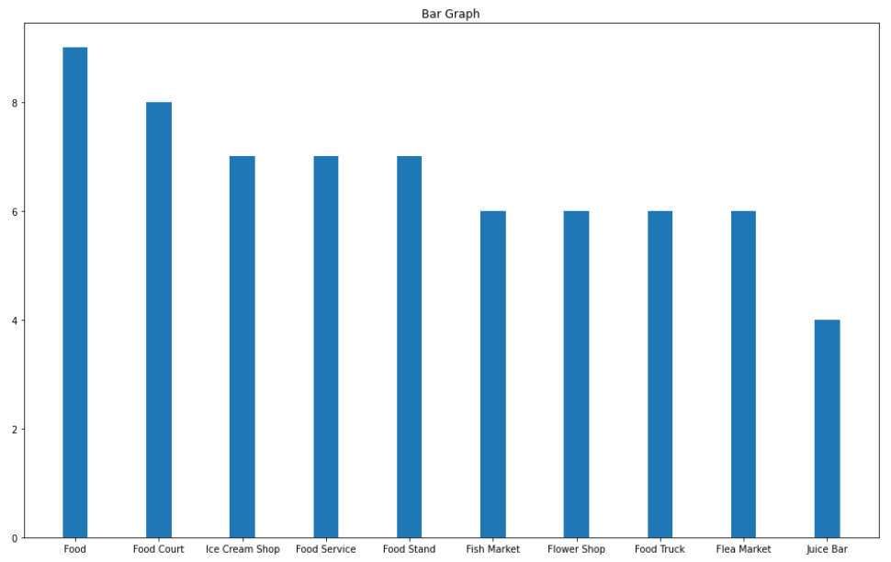
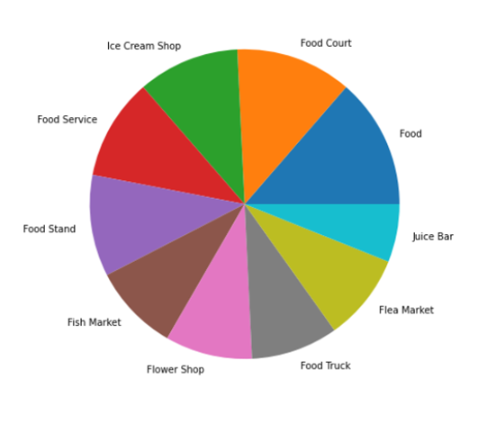
Cluster 3

Slide 10
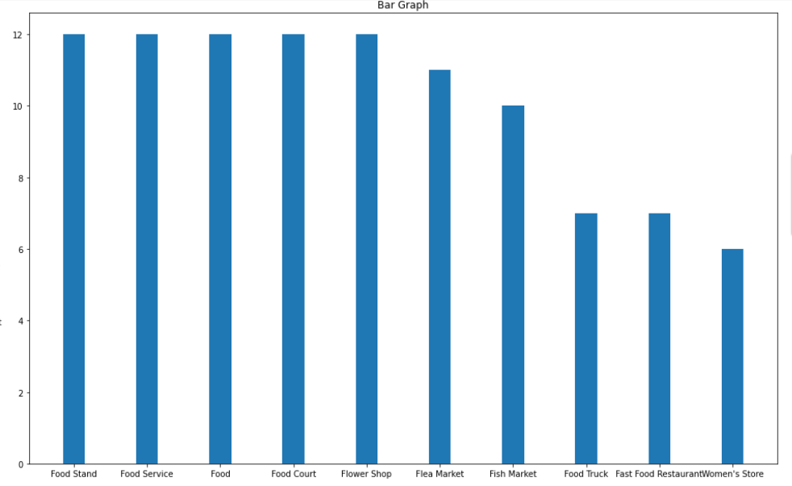
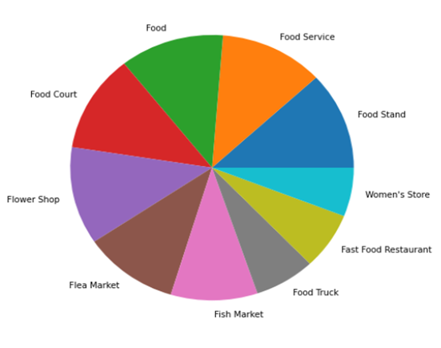
Cluster 4

Slide 11
Discussion
Cluster 3 is Selected as the best Cluster as it has equal Distribution of all Neighbourhoods.
This Cluster consists of 7 Neighbourhoods. Among the seven “Maduravoyal” is only the Municipality Area.
Municipality Areas have higher value than census Town or Panchayats. So “Maduravoyal” is selected.

Slide 12
Conclusion
The Best Neighbourhood in Chennai for living is “Maduravoyal” followed by “pallikaranai”

